Slide 1
Simulate the robot in Gazebo
Understand TFs
Design a custom robot with URDF
Simulate the robot in Gazebo

Slide 2
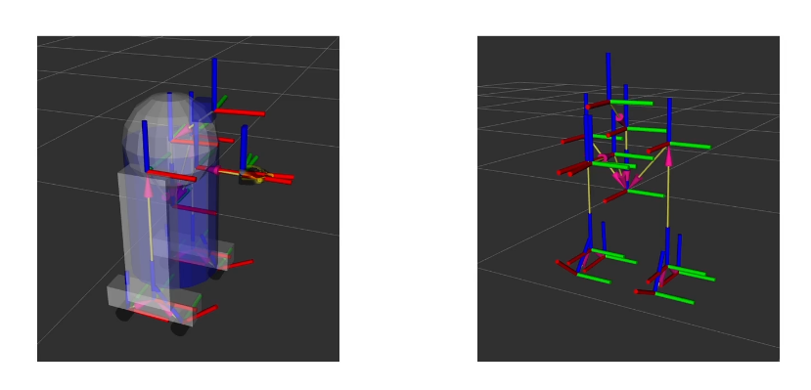
Introduction on TFs (TransForm)

Slide 3
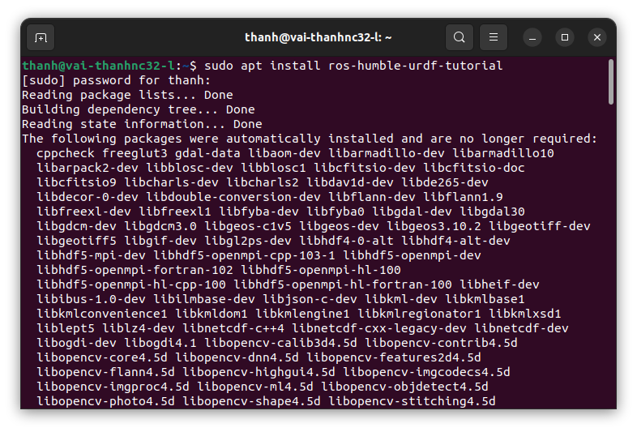
Visualise a Robot TFs in RViz 2
Installing ros-humble-urdf-tutorial

Slide 4
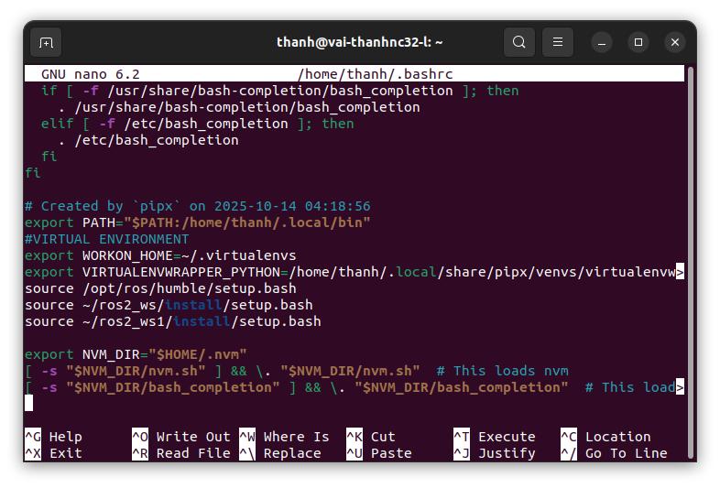
Visualise a Robot TFs in RViz 2
source /opt/ros/humble/setup.bash

Slide 5
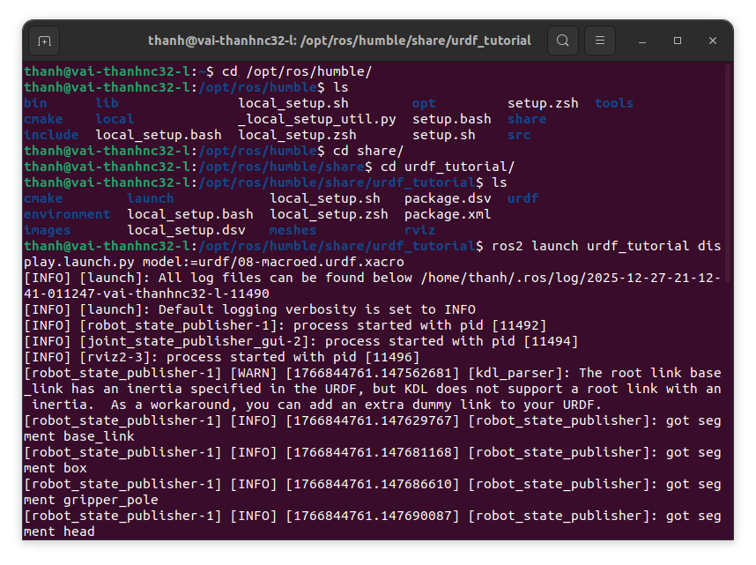
Visualise a Robot TFs in RViz 2
run an example

Slide 6
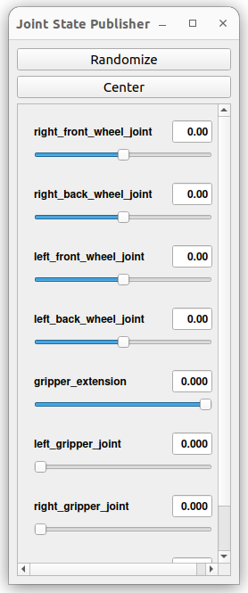
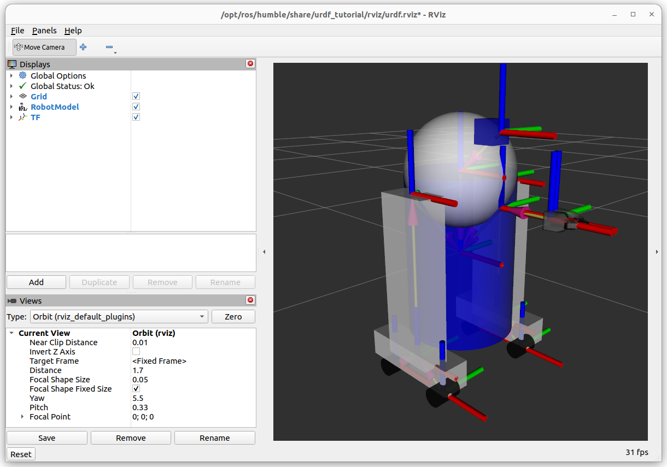
Visualise a Robot TFs in RViz 2

Slide 7
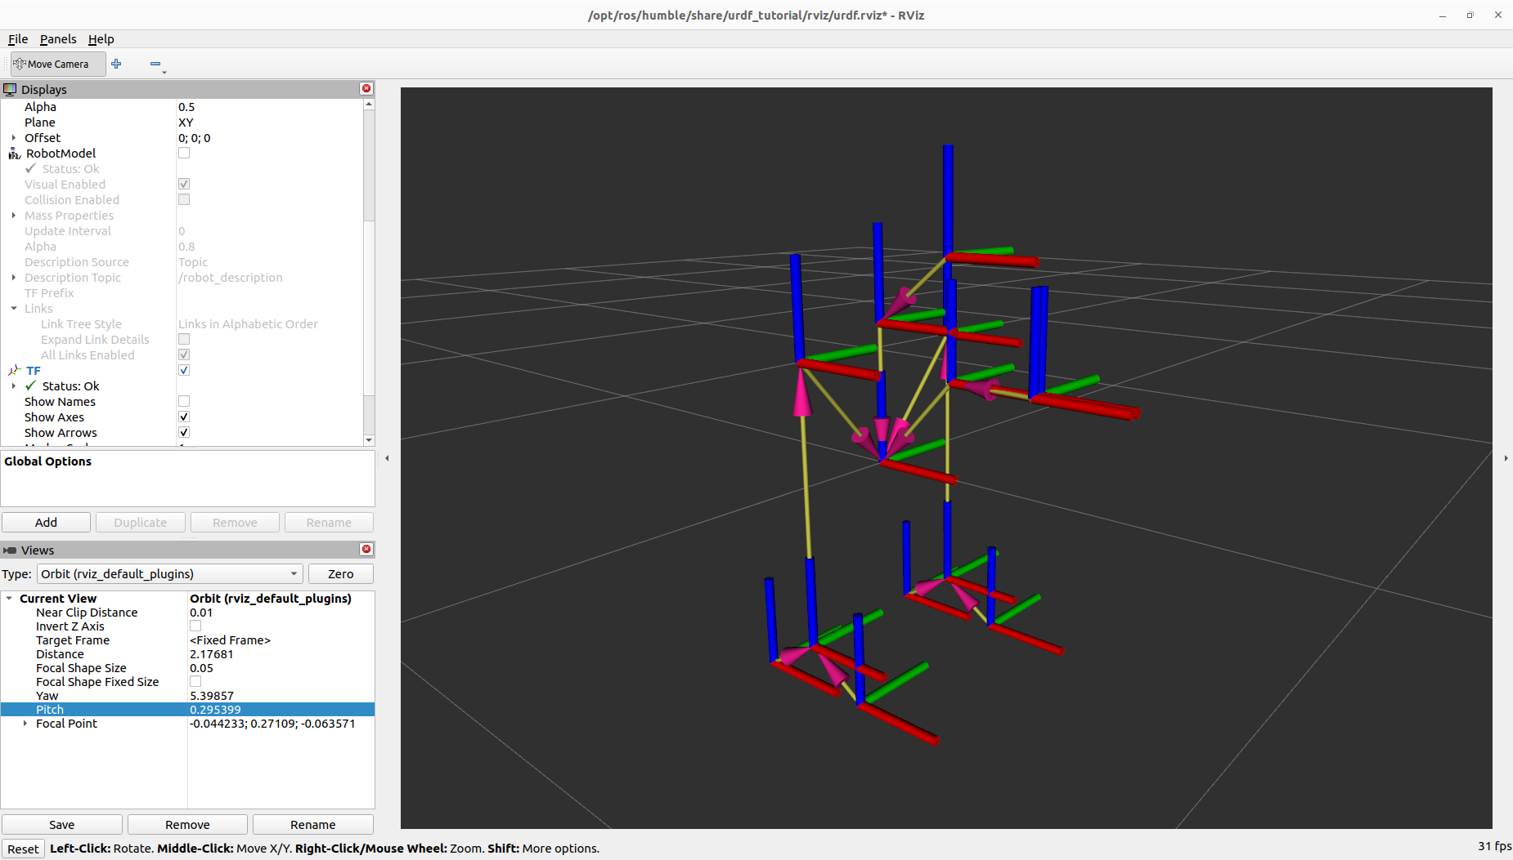
Relationship Between TFs, TF tree

Slide 8
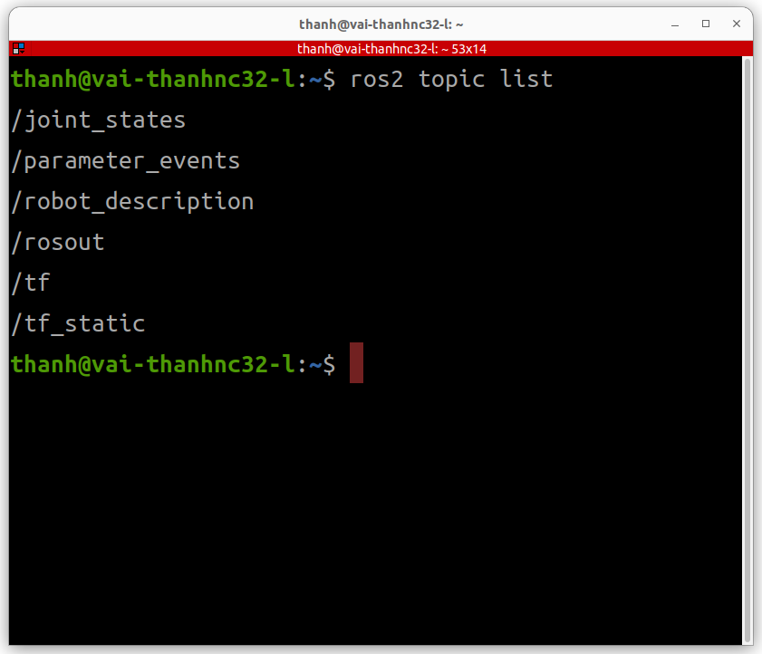
Relationship Between TFs, TF tree
view topic
ros2 topic echo /tf

Slide 9
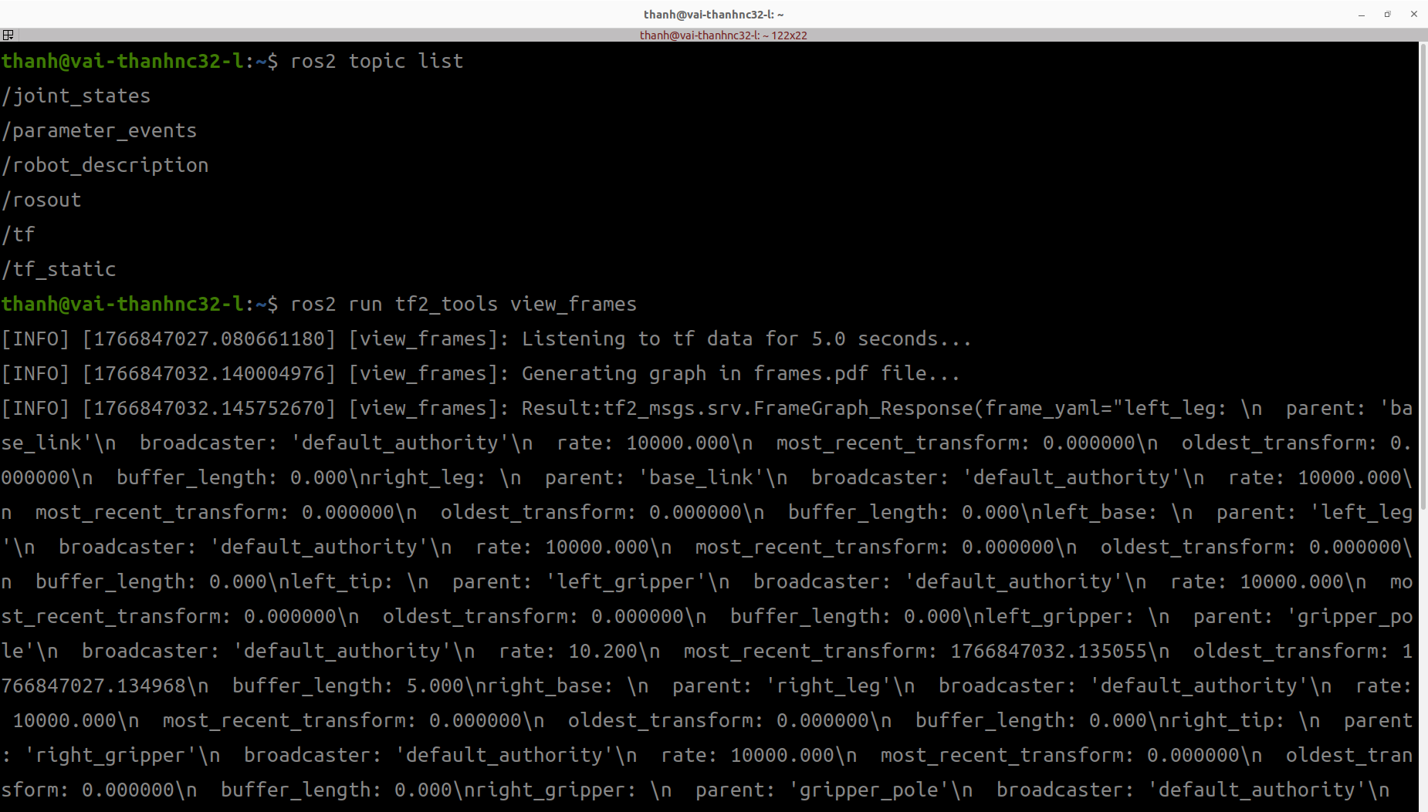
Relationship Between TFs, TF tree
view frames

Slide 10
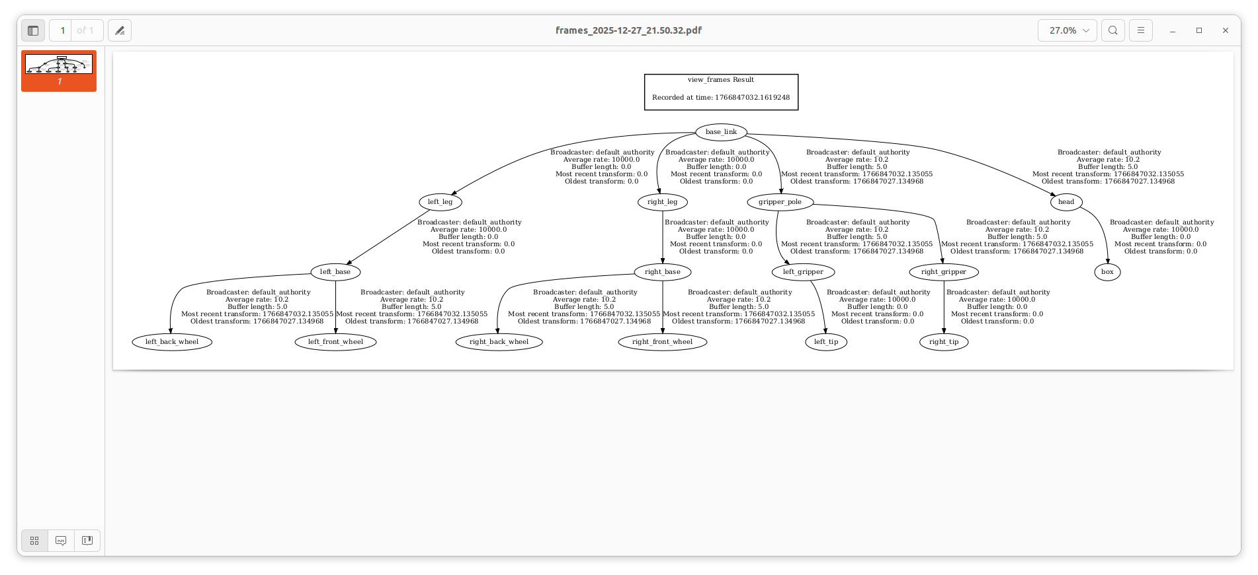
Relationship Between TFs, TF tree
view frames

Slide 11
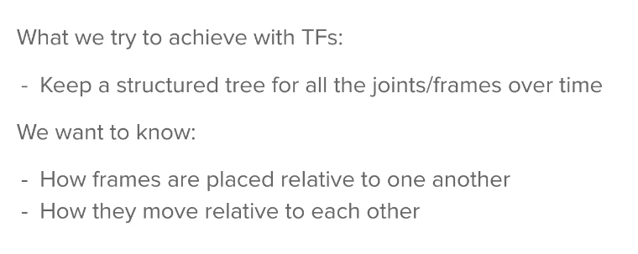
What problem are we trying to solve with TF?

Slide 12
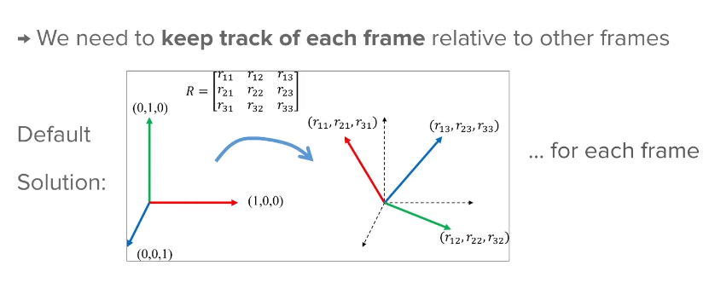
What problem are we trying to solve with TF?

Slide 13
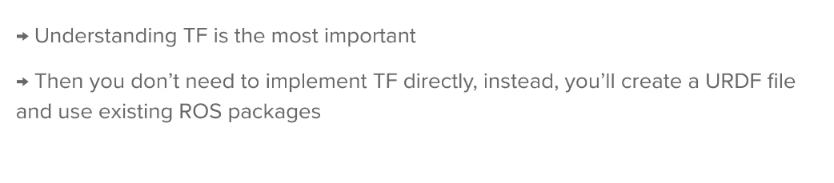
What problem are we trying to solve with TF?

Slide 14
Create a URDF for a Robot

Slide 15
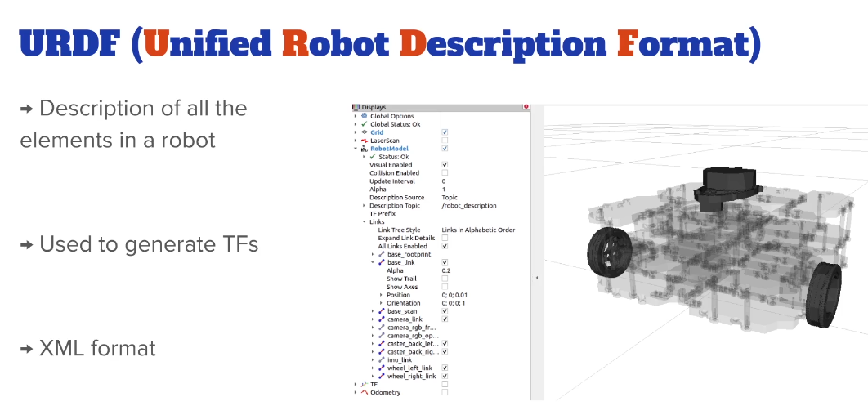
Introduction on URDF

Slide 16
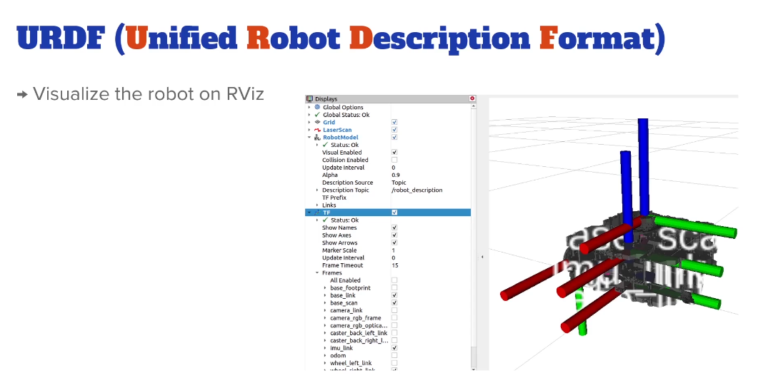
Introduction on URDF

Slide 17
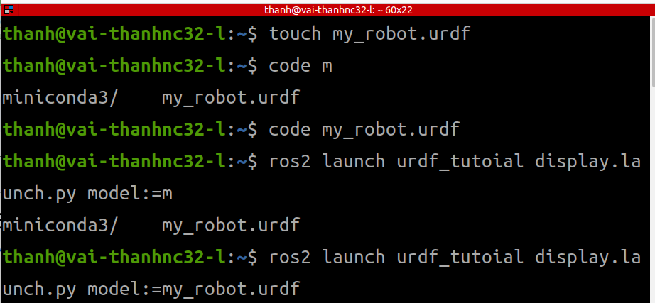
Create and Visualize a Link

Slide 18
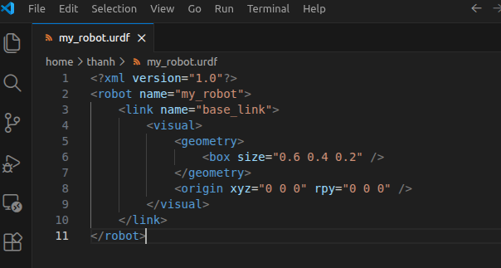
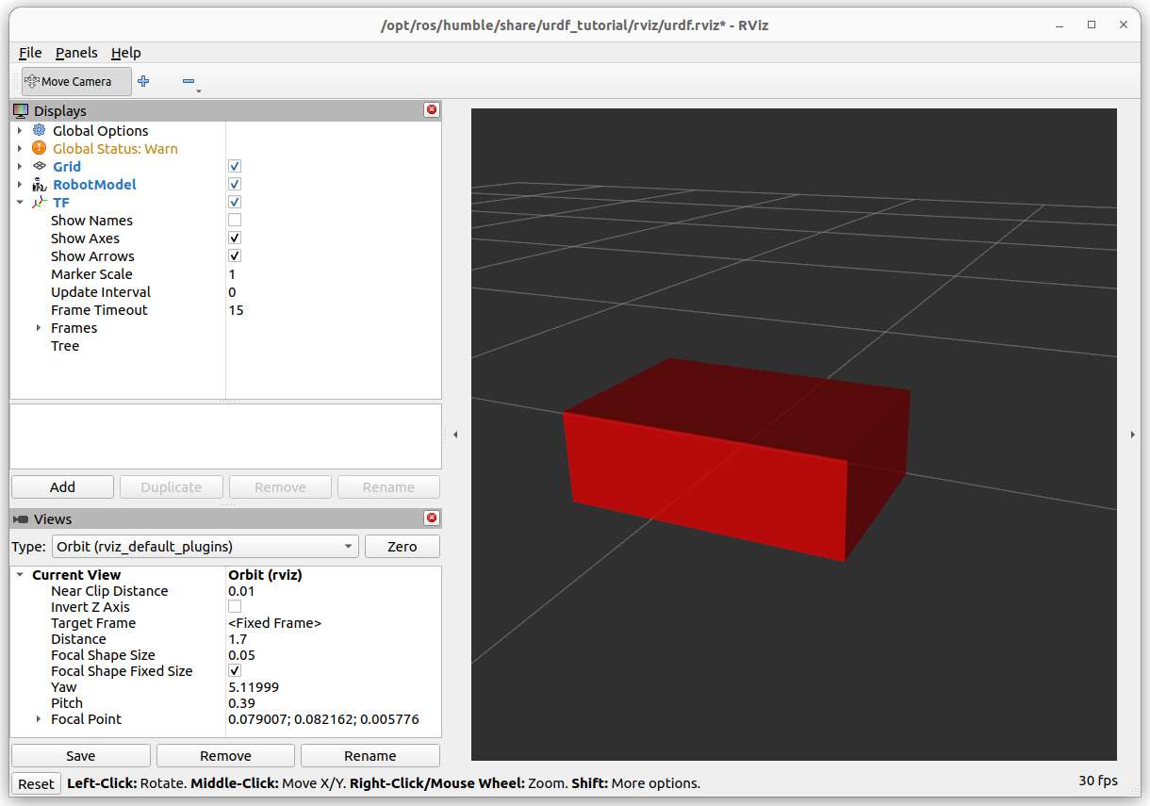
Create and Visualize a Link

Slide 19
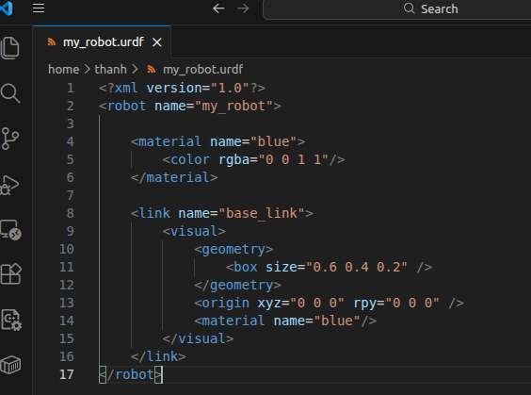
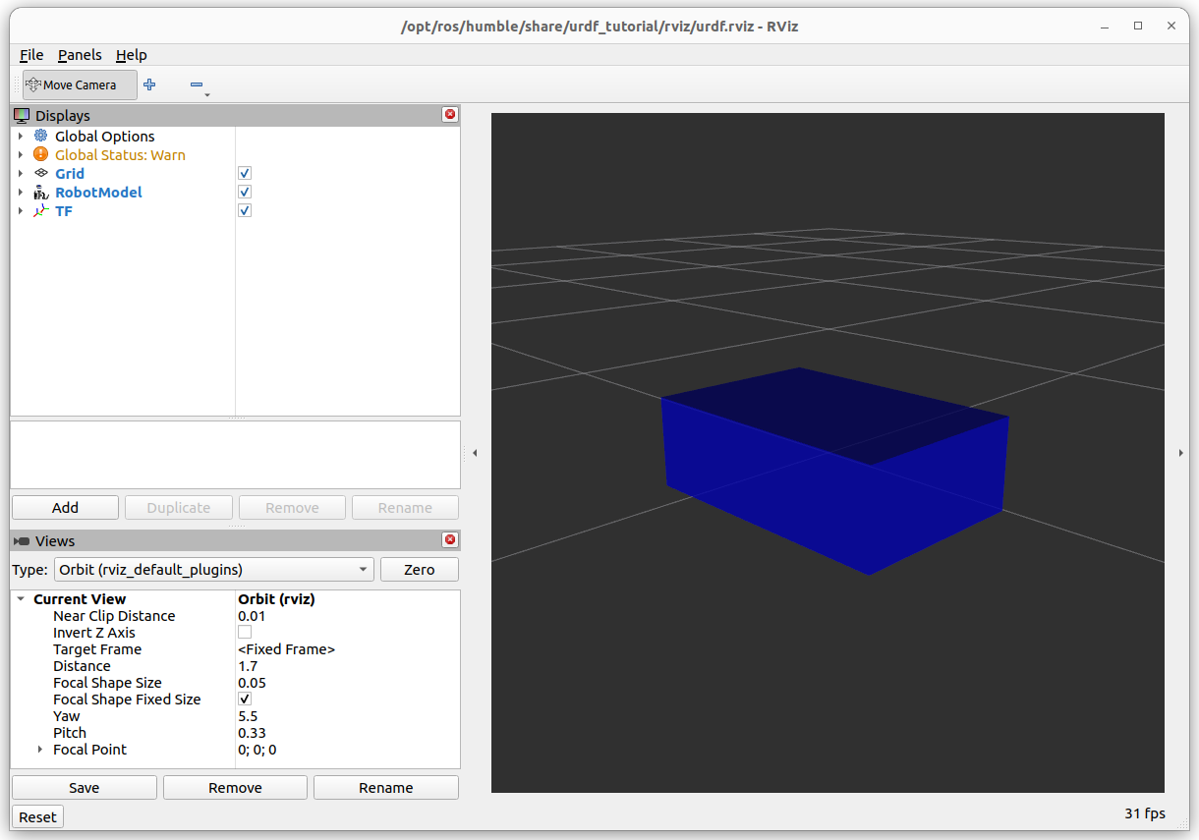
Material - Add Some Colors

Slide 20
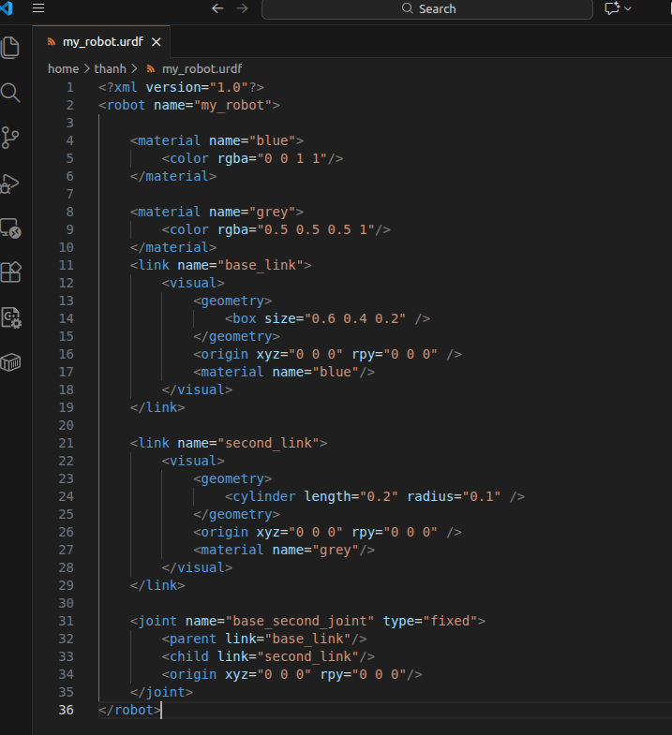
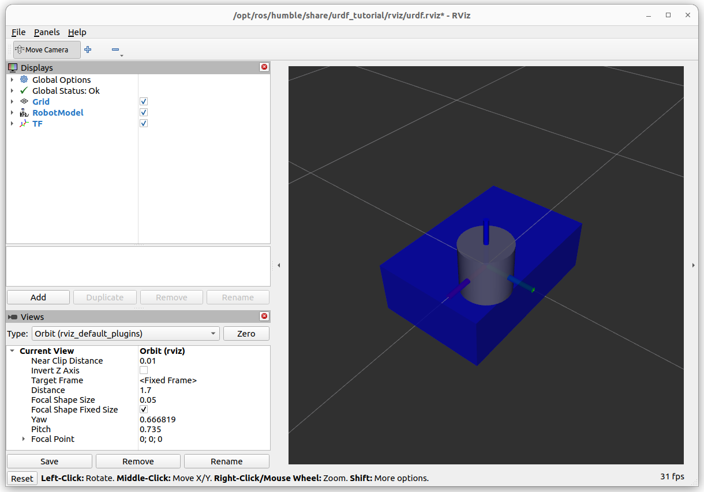
Combine 2 Links with a Joint

Slide 21
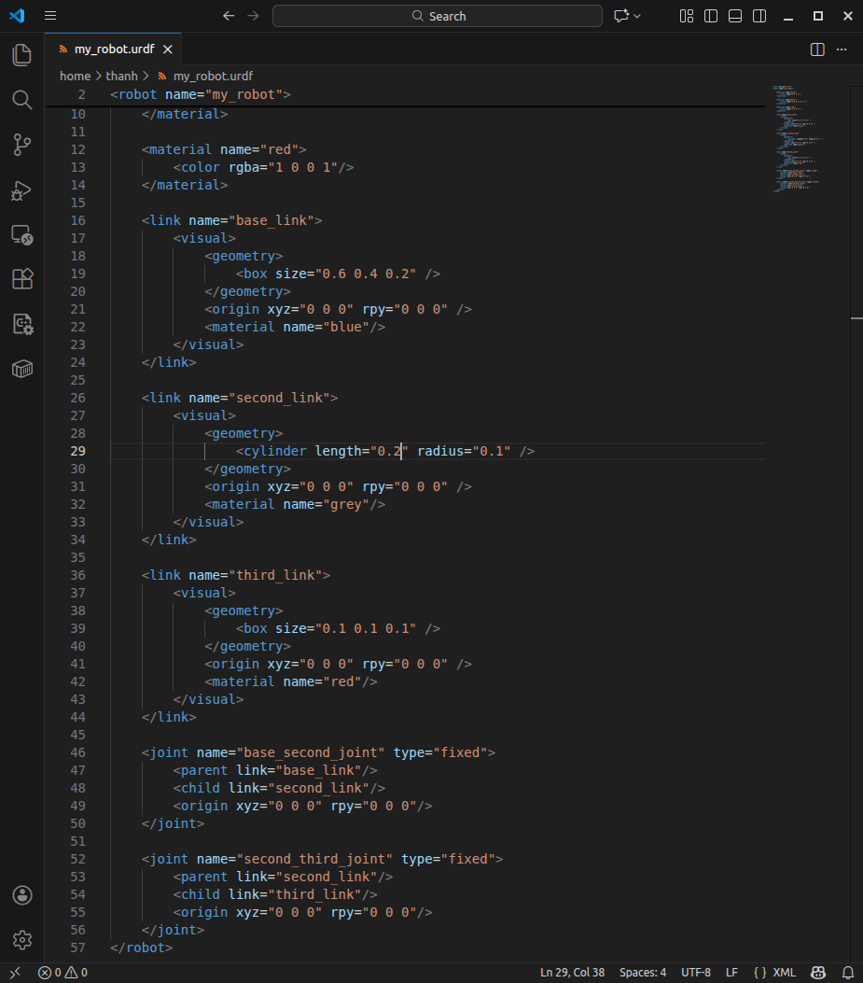
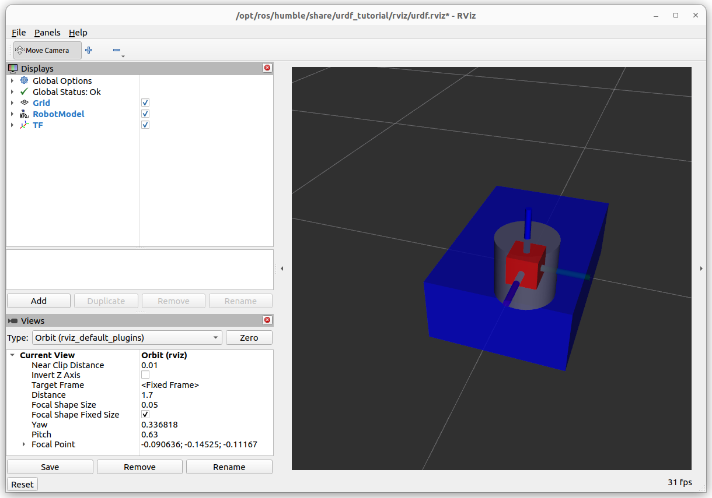
Combine 2 Links with a Joint

Slide 22
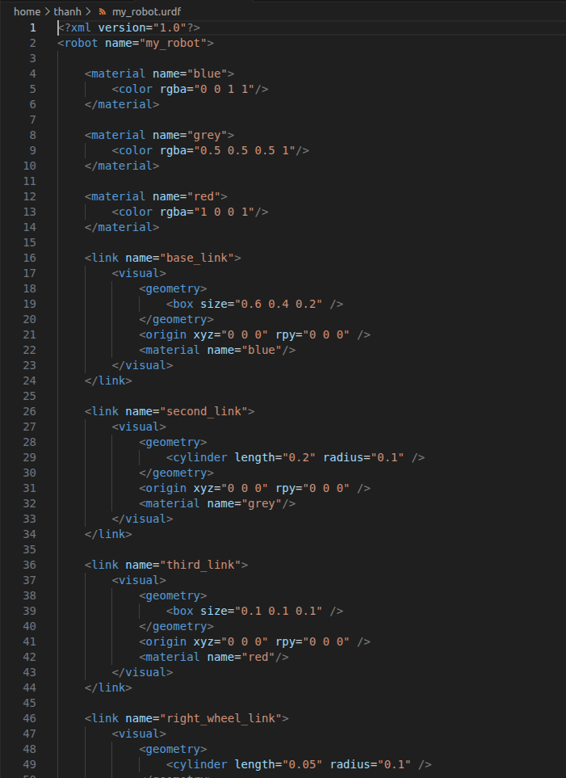
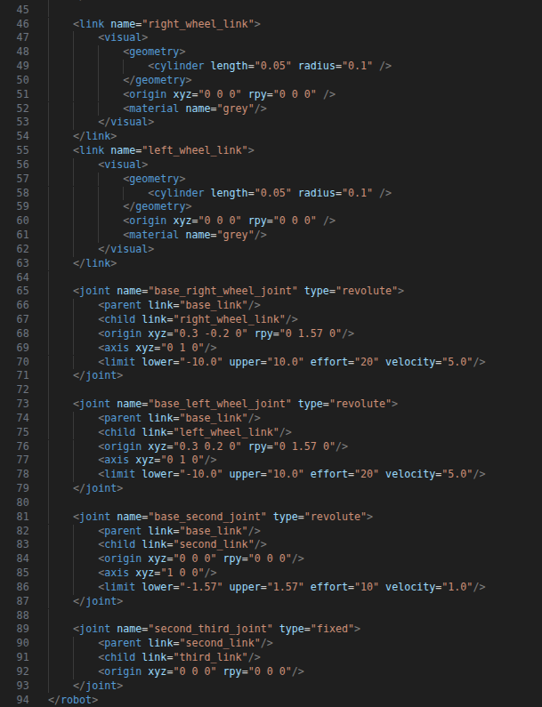
Combine 2 Links with a Joint

Slide 23
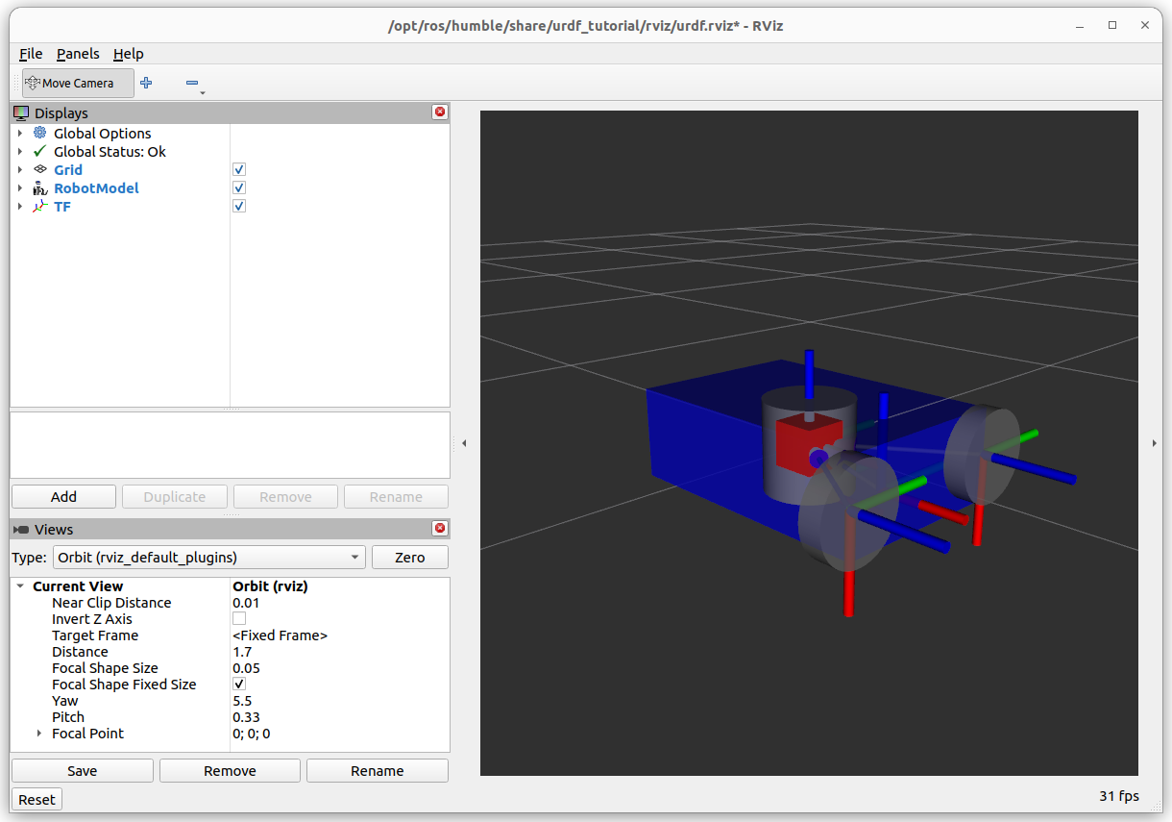
Combine 2 Links with a Joint

Slide 24

Combine 2 Links with a Joint

Slide 25
Different Types of Joints in a URDF
https://wiki.ros.org/urdf/XML/link
https://wiki.ros.org/urdf/XML/joint

